Slide 1


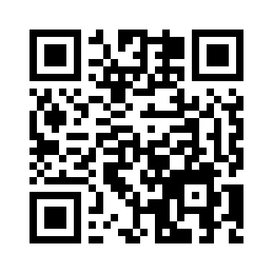

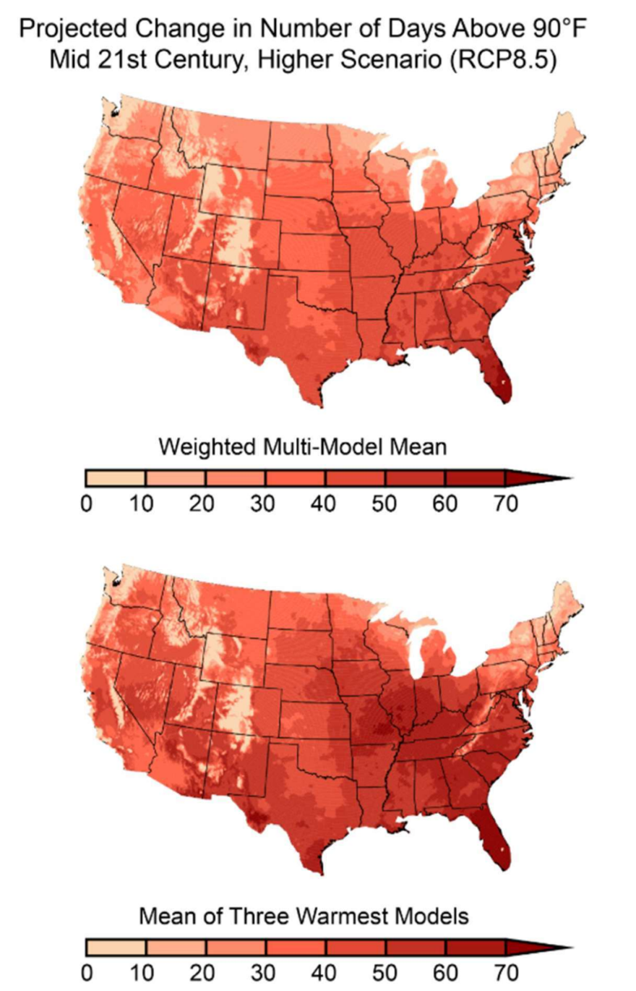
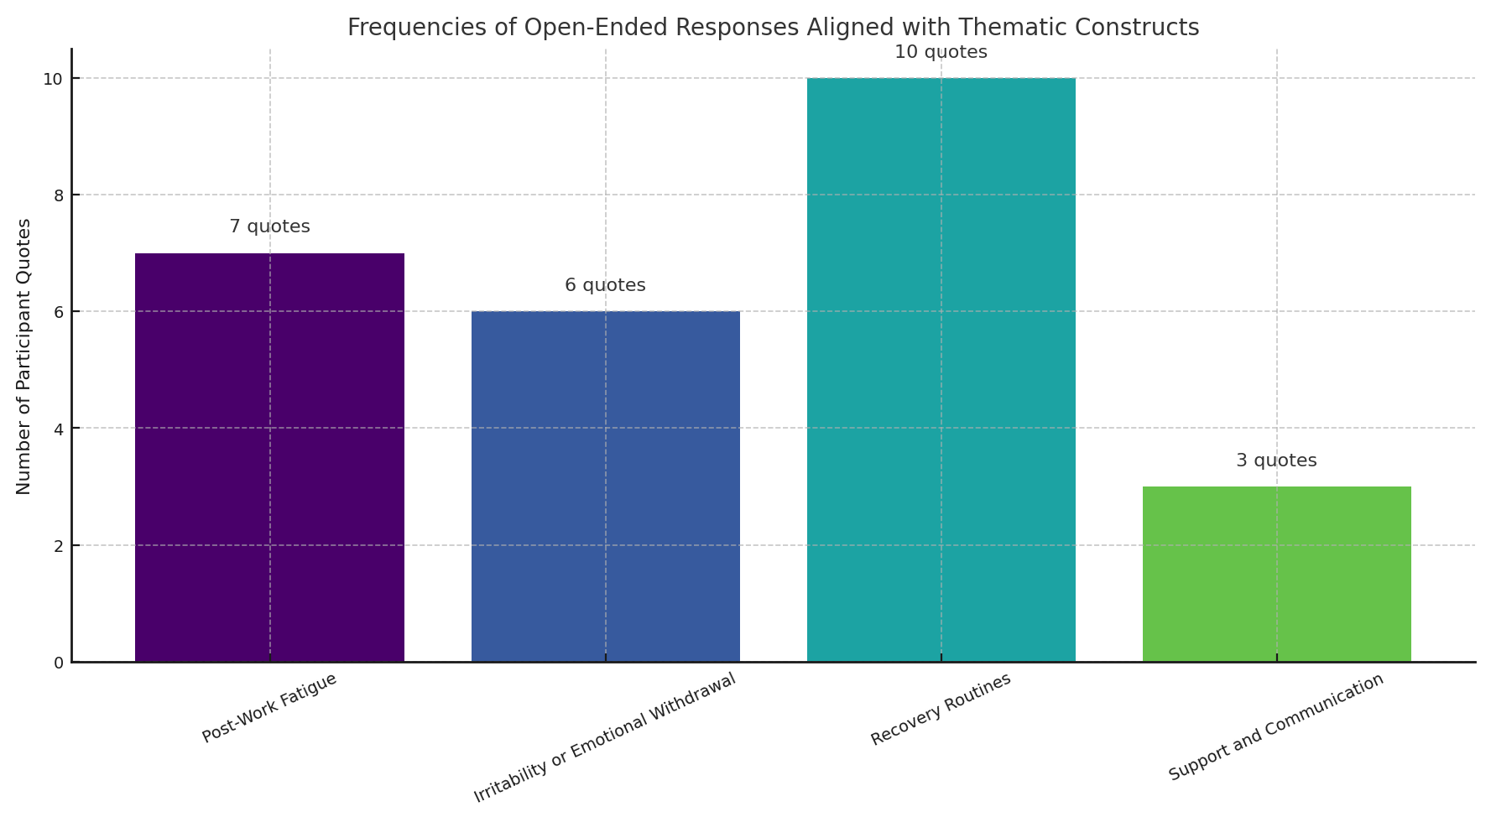
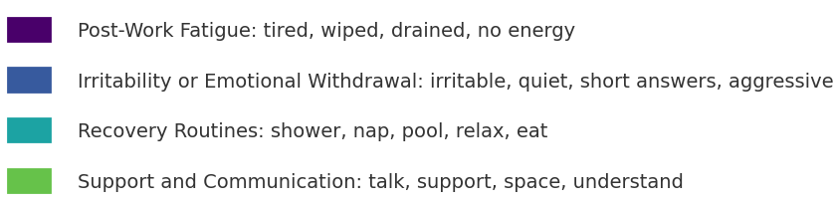
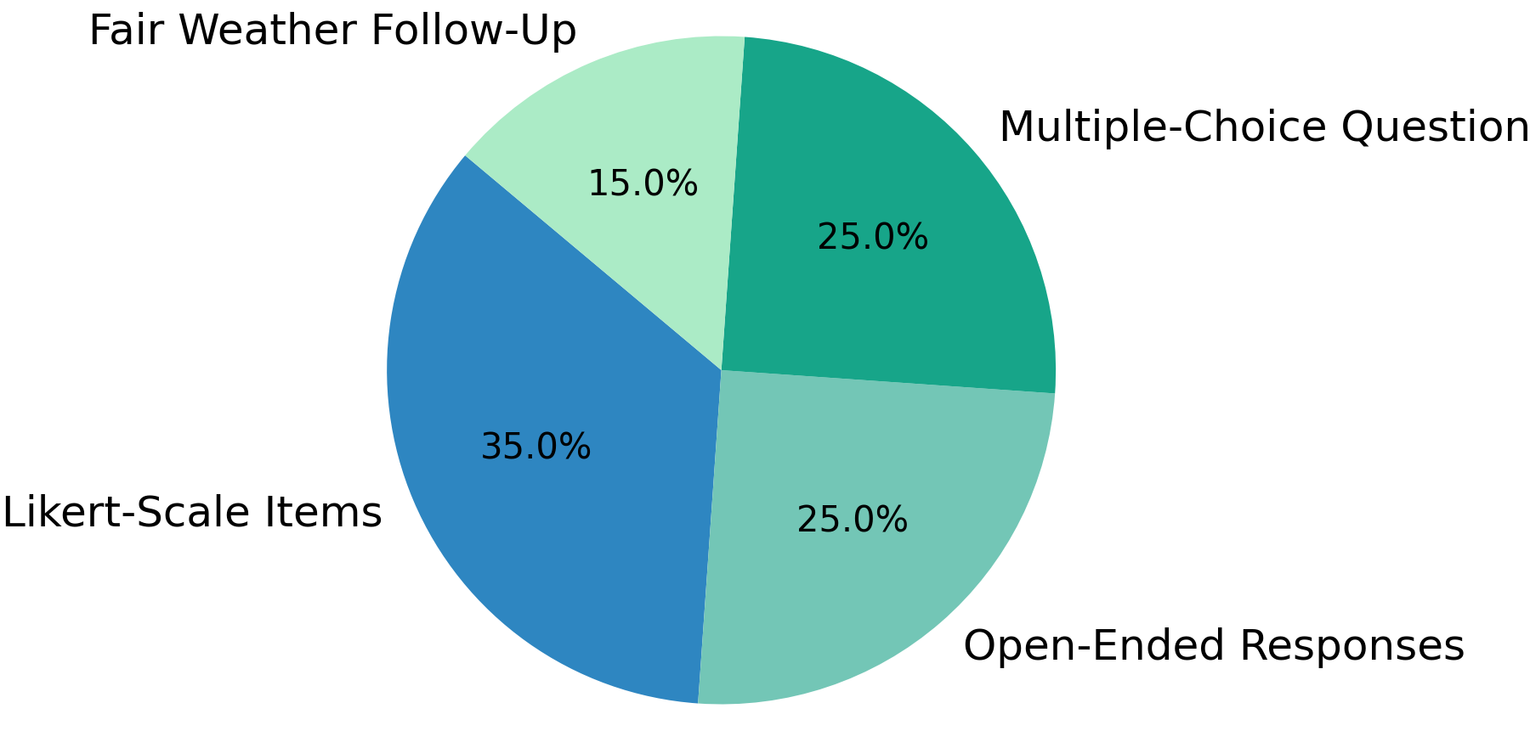
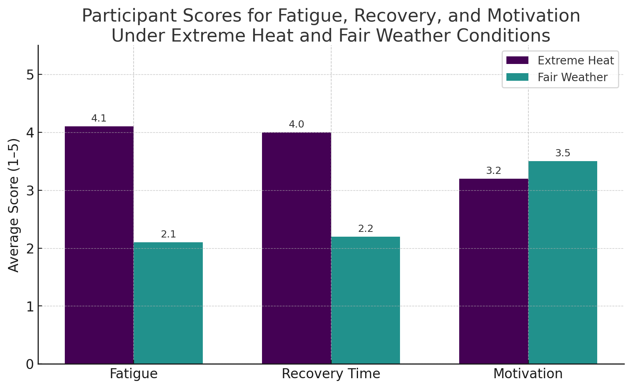



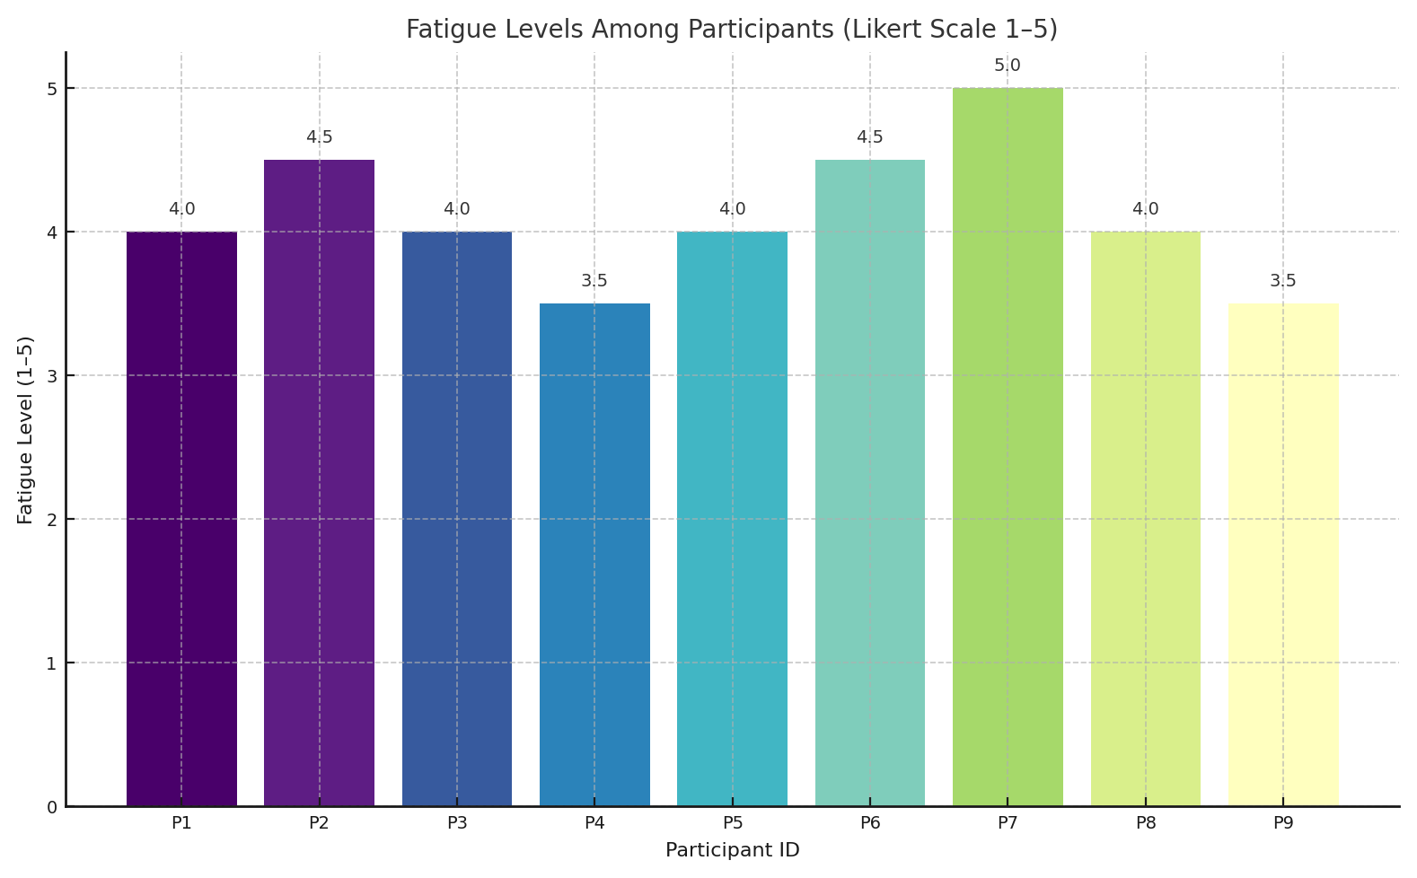

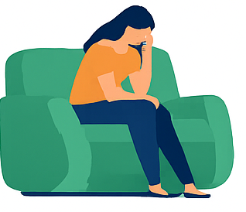
Prolonged Heat Exposure in Florida’s Construction Workforce: Mental Fatigue, Emotional Strain, and Personal Impact
U.A. Whitaker
College of Engineering
Candace S. Jungers
Master of Science in Engineering – Construction Management | Faculty Advisor: Dr. Elshall | Industry Partner: London Bay Homes
Scan For Full Report Details
Abstract
Method
Results
Florida is projected to experience over 60 additional days above 90°F by mid-century—one of the highest increases in the country. These rising temperatures create not only physical risks for construction workers, but also mounting psychological and emotional strain.
Working in the Florida heat doesn’t stop at the jobsite.
This study explores how extreme heat impacts construction workers—not just physically, but mentally and emotionally.
To explore how heat affects construction workers beyond the physical, this study used a 12-week, mixed-methods approach that combined both structured metrics and personal reflections.
Survey Design
Participants completed three Google Forms surveys:
The first two surveys collected reflections on recent work under extreme heat conditions
The third survey was administered during fair-weather conditions to serve as a comparative control
Each survey included:
Likert-scale assessments (1–5) measuring fatigue, mood, irritability, recovery, and social interaction
Multiple-choice questions addressing hydration habits, shade access, and employer support
Open-ended questions prompting workers to describe how heat affected their behavior, emotions, and family life
To reduce participant burden, open-ended responses were embedded directly into the survey form, allowing for accessible, thoughtful contributions without follow-up interviews.
Was it better in cooler weather? Yes. Survey scores improved across every category:
Fatigue dropped from 4.1 → 2.1
Recovery Time improved from 2.2 → 4.0
Motivation increased from 3.2 → 3.5
Distribution of Question Types Across All Surveys Used in the Study
DATA ANALYSIS
This study used a two-part analysis approach: descriptive statistics for scaled responses and thematic coding for open-ended reflections.
Quantitative Analysis
Likert-scale items were summarized using:
Mean
Median
Standard deviation
Multiple-choice responses were evaluated through frequency distribution to identify patterns in hydration habits, heat-related stressors, and coping behaviors. A third survey administered under fair-weather conditions was analyzed using the same structure to allow environmental comparisons.
This approach helped isolate temperature as a variable influencing mental fatigue, motivation, and recovery.
Over 12 weeks, participants described what it really feels like to push through long days in high heat: being wiped out, short-fused, and distant when they get home.
Even with basic coping strategies like cold showers or isolation, the exhaustion lingers. Workers say it affects their focus, their relationships, and how they show up—for work, and for their families.
Objectives
Participants and Recruitment
Mental Resilience
Nine mid-level construction workers were recruited from active job sites in Southwest Florida managed by London Bay Homes. The group included:
Project managers and superintendents, who worked outdoors or in semi-conditioned environments
Electricians, typically working in confined, poorly ventilated spaces
Stucco and framing workers, exposed to direct sunlight with no climate control
Recruitment occurred during the first four weeks of the study, and participants were invited based on their consistent exposure to high heat. All surveys were anonymous and conducted digitally, with verbal consent obtained before participation.
Assess fatigue, irritability, and emotional response under thermal stress
Qualitative Analysis
Open-ended responses were analyzed using a manual thematic coding process. Each entry was reviewed and sorted by emotional tone, coping behavior, and stress response. Recurring keywords were tagged (e.g., “tired,” “quiet,” “shower,” “understand”) and grouped into four dominant categories:
Post-Work Fatigue
Emotional Withdrawal
Conclusion
This study demonstrates that extreme heat affects more than just physical performance. Workers reported higher fatigue, emotional withdrawal, and slower recovery during hot conditions—while cooler weather was linked to better mood, motivation, and family engagement.
Open-ended responses revealed a pattern of passive coping and isolation, with no formal employer-led strategies reported. These findings show a clear link between environmental stress and diminished emotional resilience.
The study successfully met its objectives, highlighting the mental, behavioral, and relational impacts of heat exposure. As jobsite conditions grow more intense, future research should explore structured interventions to support both physical and psychological recovery in the construction workforce.
Work-Life Strain
Examine how on-site heat affects home behavior and family relationships
Recovery Routines
Support & Communication
Coping Strategies
Results
Track hydration, decompression routines, and passive recovery patterns
What did the data say? Workers were tired. Not just physically—but mentally and emotionally drained. All participants reported high fatigue levels, averaging between 3.5 and 5.0 out of 5.
Acknowledgments
Condition Comparison
What did workers say about it? They didn’t just feel tired—they felt disconnected, withdrawn, and emotionally flat:
I would like to thank Florida Gulf Coast University and the U.A. Whitaker College of Engineering for supporting this research.
Special thanks to the professionals who participated in the surveys, and to London Bay Homes—particularly Brian McKim, Stephen Wilson, and Mark Wilson—for their support and access to job sites.
I am also grateful to my faculty mentors, especially Dr. Elshall, and to my family for their ongoing encouragement throughout this project.
Contrast survey outcomes on high-heat days vs. fair-weather conditions
“I feel absolutely wiped and I can’t do anything for the rest of the day.” “Not much energy to socialize… I’m more quiet and prefer to be alone.” “The heat makes me more aggressive and short fused.”

